Slide 1
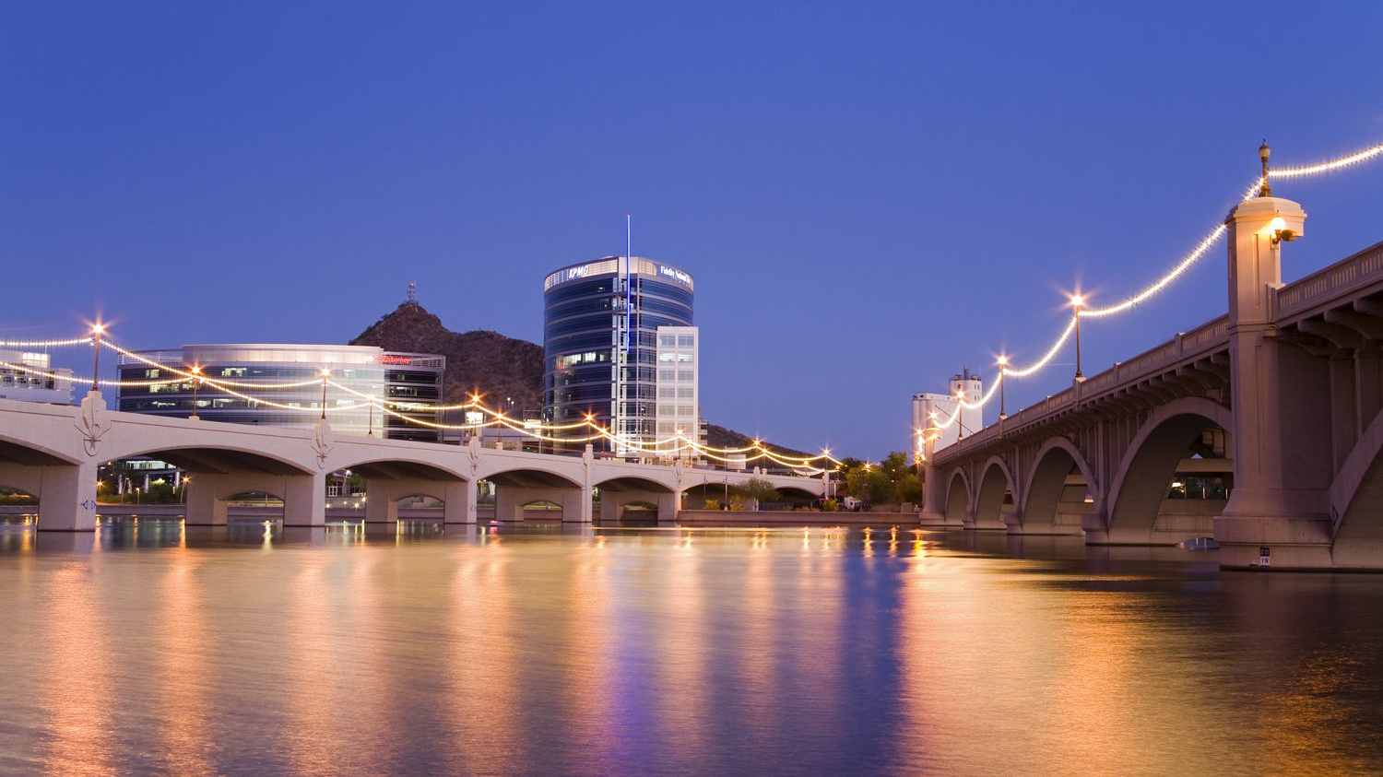
Aquatic Data Analysis from Deployable, Autonomous Boat
Rodney Staggers, Sarah Bearman, Jnaneshwar Das
School of Earth and Space Exploration
Arizona Space Grant Consortium
April 17TH, 2021
Source: tripsavvy.com

Slide 2
ABSTRACT
This projects serves to mechanize an autonomous catamaran boat to deploy/ascend a sonde across various locations in Tempe Town Lake in order to observe its biogeochemical attributes over time.

Slide 3
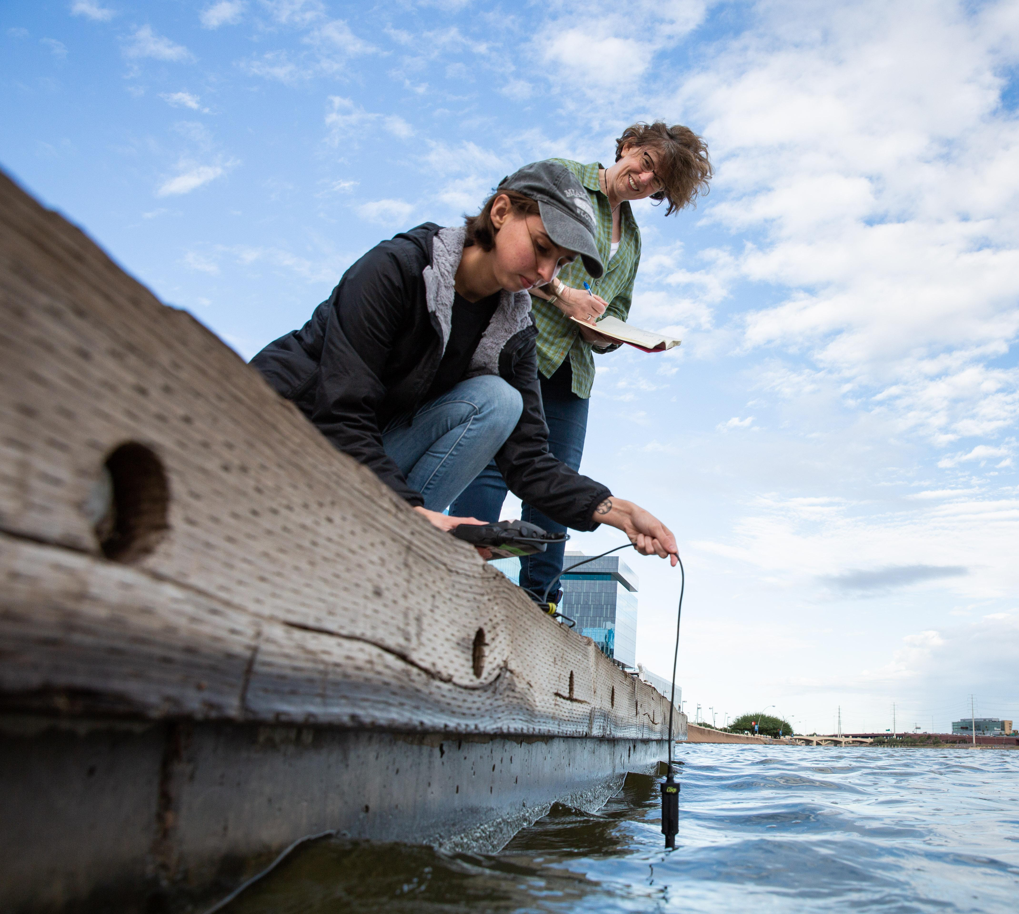
CURRENT PRACTICES AT THE LAKE
Prof. Hilairy Hartnett of Arizona State University (in conjunction with CAP LTER)
Years of data from Tempe Town Lake
Source: asunow.asu.edu
Notes:
Tempe Town Lake
Man-made structure
Located in Tempe, AZ
~378,000,000 Liters in volume

Slide 4
LIMITATIONS OF PRACTICE
Utilizes one sonde at one specific location
Lacks spatial resolution
Possible data gradients at diverse locations
Source: asunow.asu.edu

Slide 5
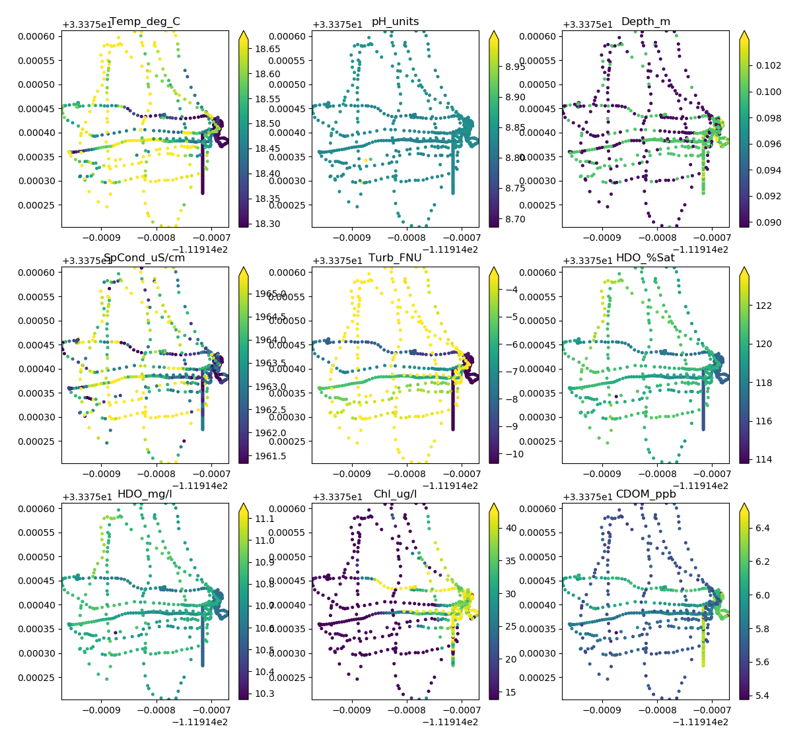
LIMITATIONS OF PRACTICE
From Lab testing (without winch and housing system), this data was collected:

Slide 6
LIMITATIONS OF PRACTICE
Only 1.2cm range of depth
Want to add additional dimension to analyze

Slide 7
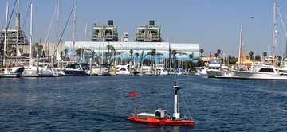
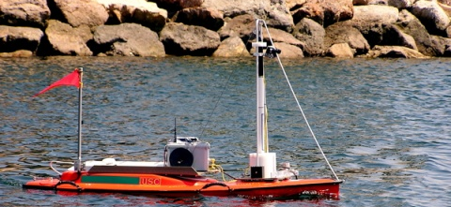
PRIOR RESEARCH
University of Southern California
Conducted in 2007
Headed by Professor Gaurav Sukhatme
Source: https://viterbi.usc.edu/news
Source: https://viterbi.usc.edu/news

Slide 8
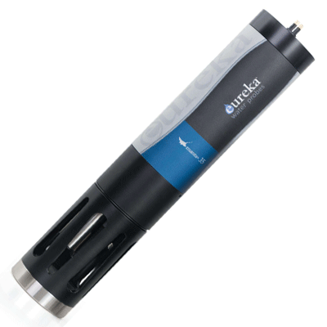
COMPONENTS
Winch
Arduino Uno
Manta+ 35
Source: Aqualab.com/au
Notes:
Potential expansion in crafting devices that can sample, explore, and gather information from environments when instruments are expensive, or low in quantity.
Autonomous sampling can aid researchers in extracting data from prime regions of heightened biogeochemical activity,
Could optimize an efficient path of observation.

Slide 9
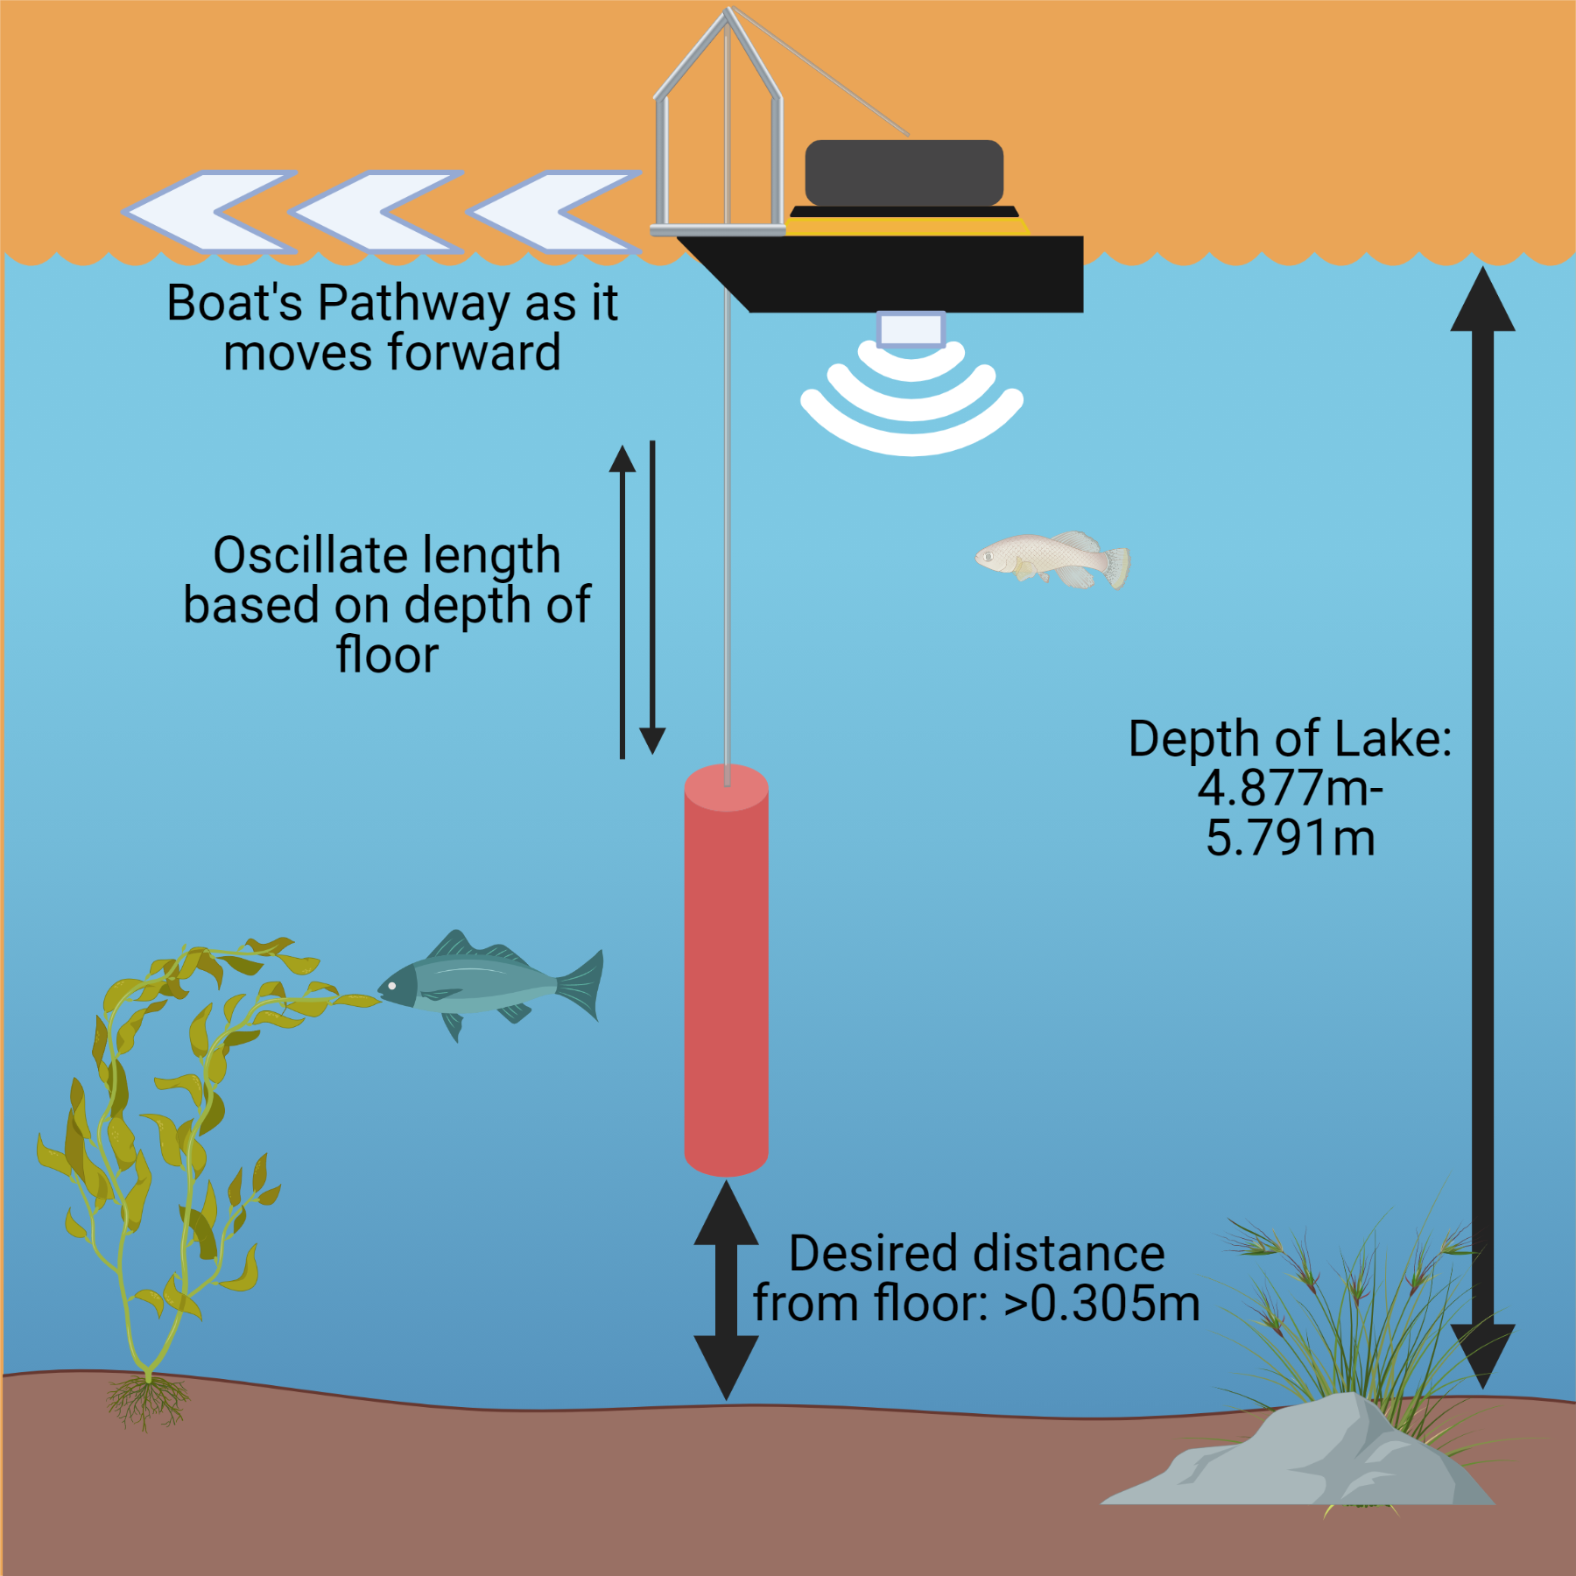
REQUIREMENTS/ OBJECTIVES

Slide 10
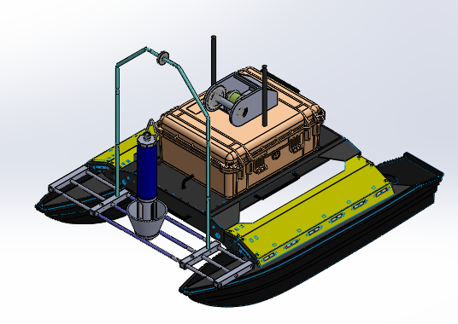
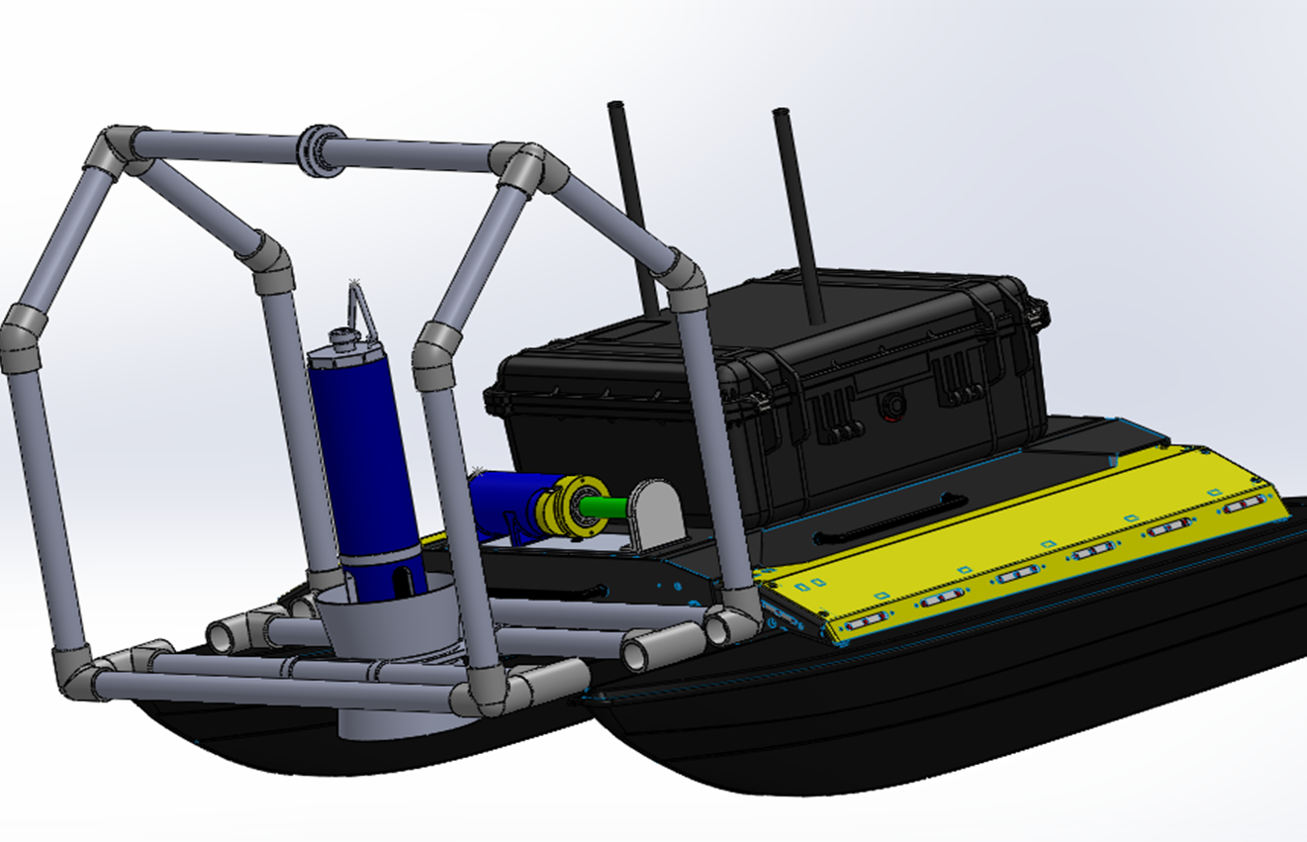
METHODS

Slide 11
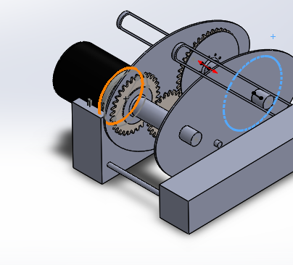
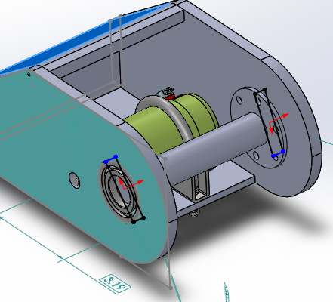
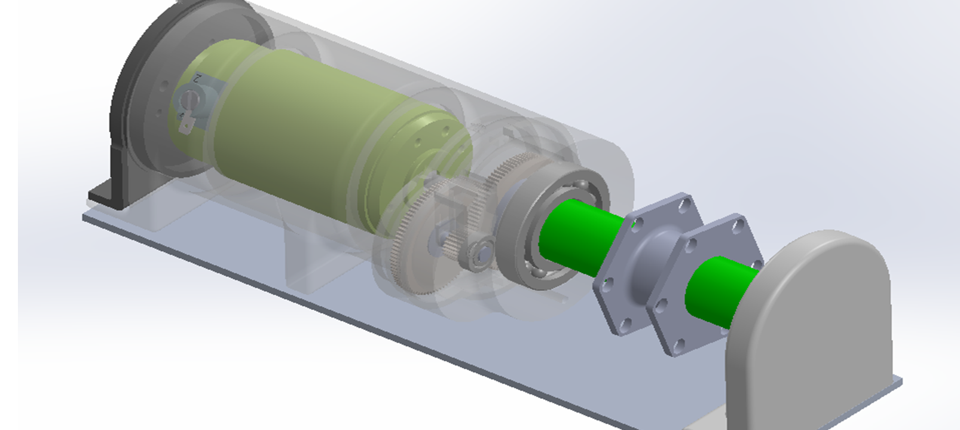
CAD MODELING FOR WINCH
Initial Intermediate
Finalized

Slide 12
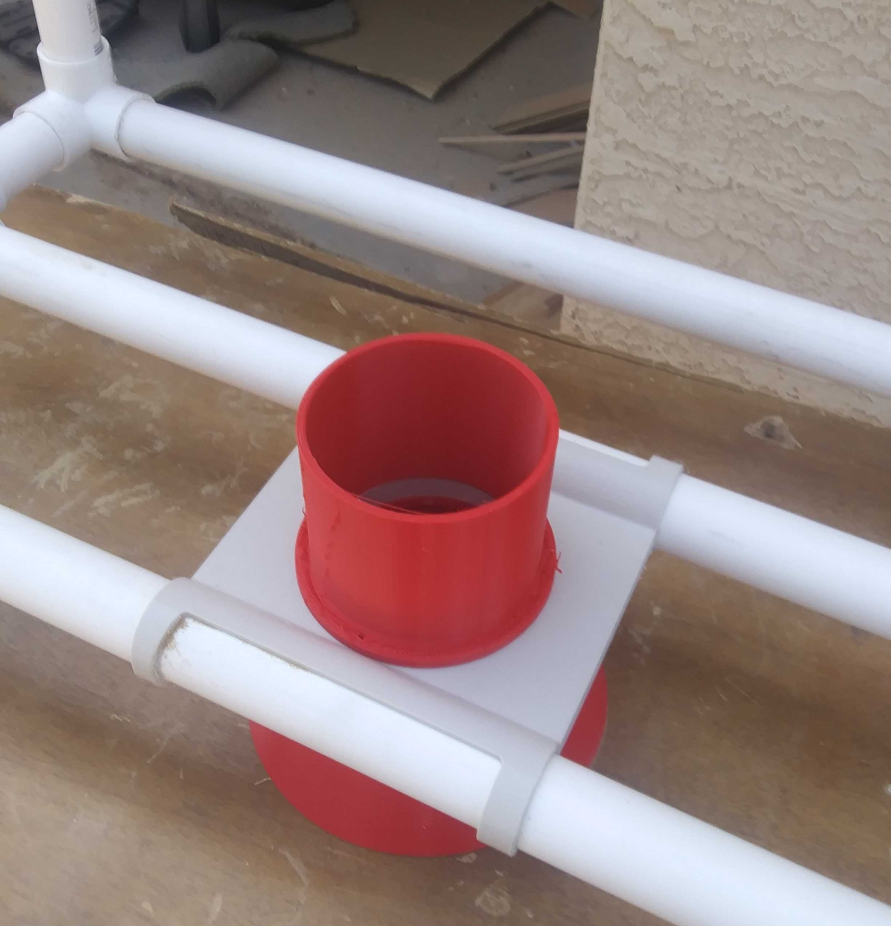
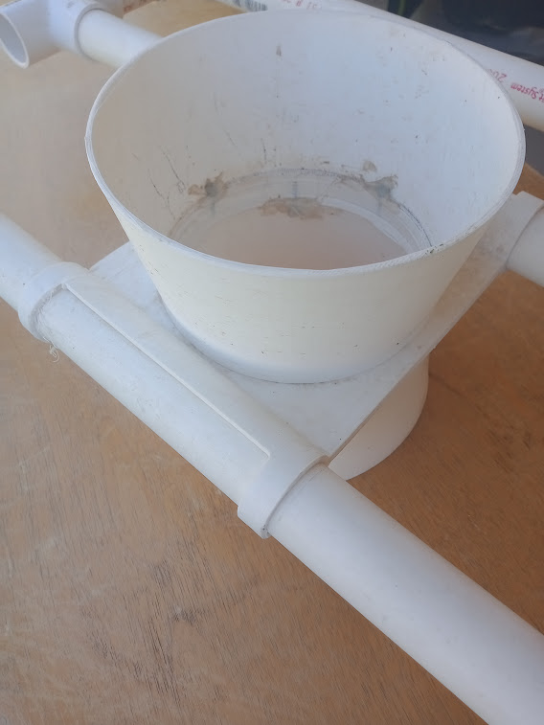
CAD MODELING FOR HOUSING UNIT

Slide 13
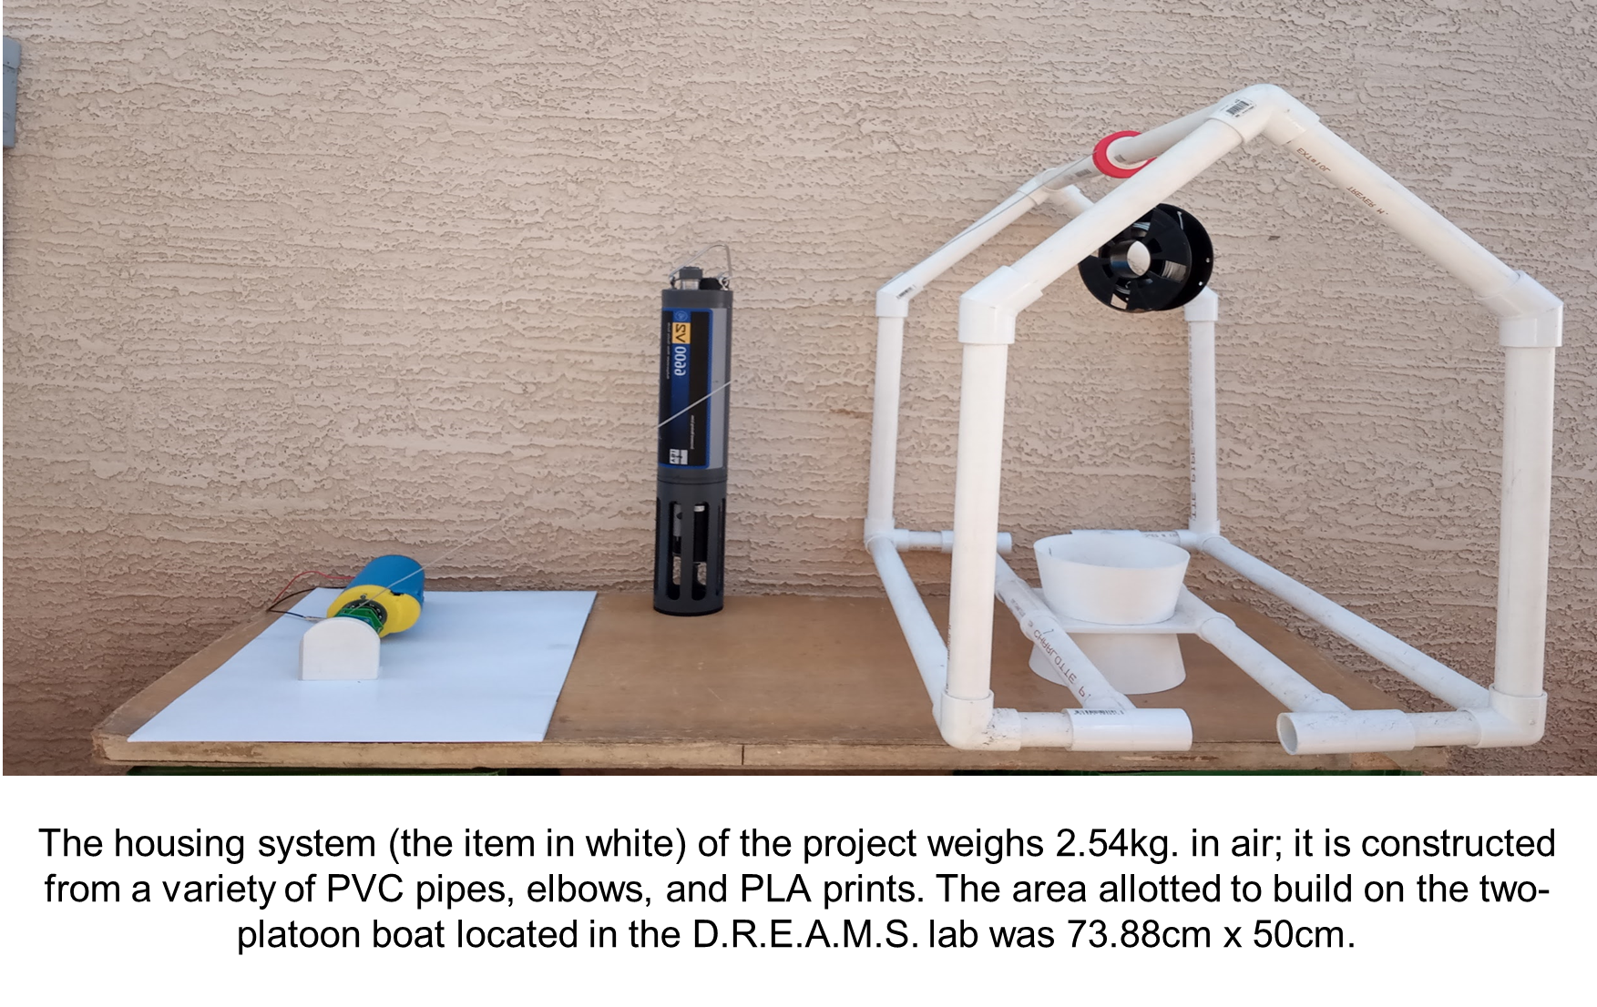
REAL-LIFE MODELS
Must withstand torque of 0.5N*m
2.54cm diameter spool
Sonde weight of 4.0kg (air)/ 4.4kg (water)
Powered by 12V battery
Housing System Weighs 8.11kg

Slide 14
RESULTS

Slide 15
CONCLUSIONS
Final Cost: $180
Sans Manta+ 35 and PLA
Upcoming Plans:
Finish ROS Integration
Perform Lake Tests

Slide 16
DISCUSSION
Potential for Autonomous Sampling Devices
Expand usage of expensive instruments
Extracting data from prime regions of heightened biogeochemical activity
Optimize path of observation
Notes:
Potential expansion in crafting devices that can sample, explore, and gather information from environments when instruments are expensive, or low in quantity.
Autonomous sampling can aid researchers in extracting data from prime regions of heightened biogeochemical activity,
Could optimize an efficient path of observation.

Slide 17
ACKNOWLEDGEMENTS
Thanks to the D.R.E.A.M.S. LAB and special thanks to Jnaneshwar Das, Sarah Bearman, and Darwin Mick!
A Special Thanks also to the Arizona State University Space Grant Program!

Slide 18
Thank You!

